Slide 1
Project Estimation Techniques
COMP6100001 - Software engineering
Session 12
Kenny Jingga, S.Kom., M.T.

Slide 2
Session 12 – Project Estimation Techniques
Learning objectives
At the end of this session, students will be expected to be able to:
Understand the Purpose and Importance of Project Estimation
Describe Key Estimation Techniques and Their Applications
Explore Software Sizing and Effort Estimation Models

Slide 3
Session 12 – Project Estimation Techniques
Content outline
Estimation Techniques
Software Sizing Techniques
Effort and Cost Estimation Models

Slide 4
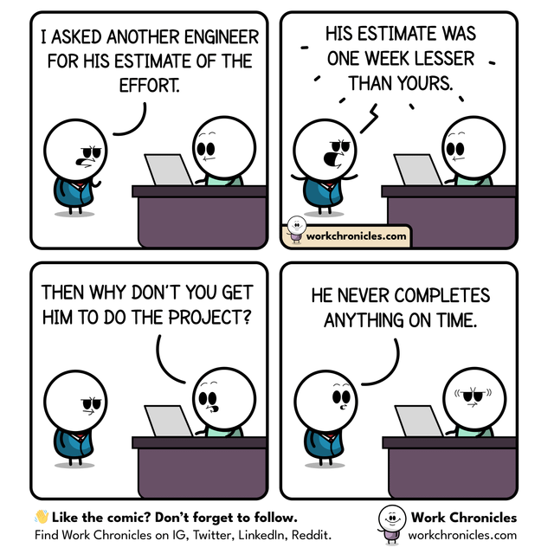
Estimation Techniques
Expert Judgement
Definition: Relying on the experience and intuition of experts.
Advantages: Quick and easy.
Disadvantages: Subjective and may be biased.

Slide 5
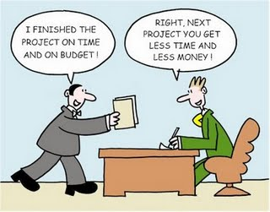
Estimation Techniques
Analogous Estimation
Definition: Using historical data from similar projects.
Advantages: Useful when limited project details are available.
Disadvantages: Accuracy depends on similarity between projects.

Slide 6

Estimation Techniques
Parametric Estimation
Definition: Using mathematical models with project parameters.
Example: Estimating effort based on lines of code (LOC).
Advantages: More objective and scalable.
Disadvantages: Requires accurate parameters and models.

Slide 7
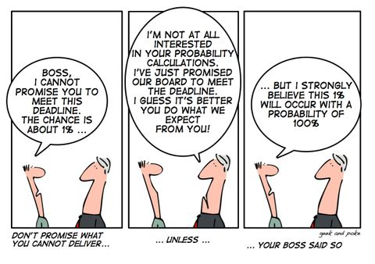
Estimation Techniques
Three-Point Estimation (PERT)
Definition: Uses optimistic (O), most likely (M), and pessimistic (P) estimates.
Formula: Estimated Time = (O + 4M + P) / 6
Advantages: Accounts for uncertainty.
Disadvantages: More time-consuming.

Slide 8
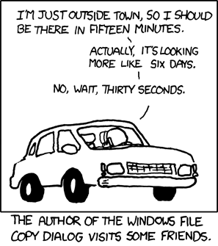
Estimation Techniques
Time Estimation

Slide 9
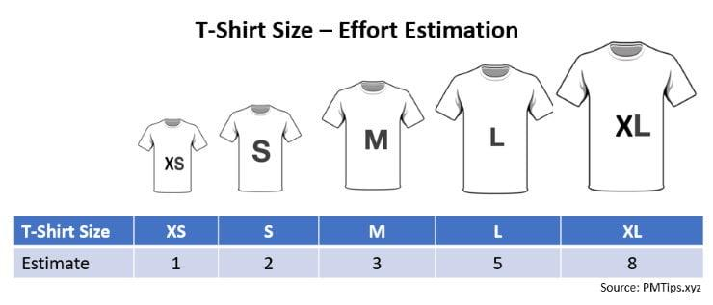
Estimation Techniques
Improving time estimates
Prevent conformity bias
Do you have a comparable experience to base an estimate on?
How much design do you need for each task?
Break down the task into smaller tasks and estimate them

Slide 10
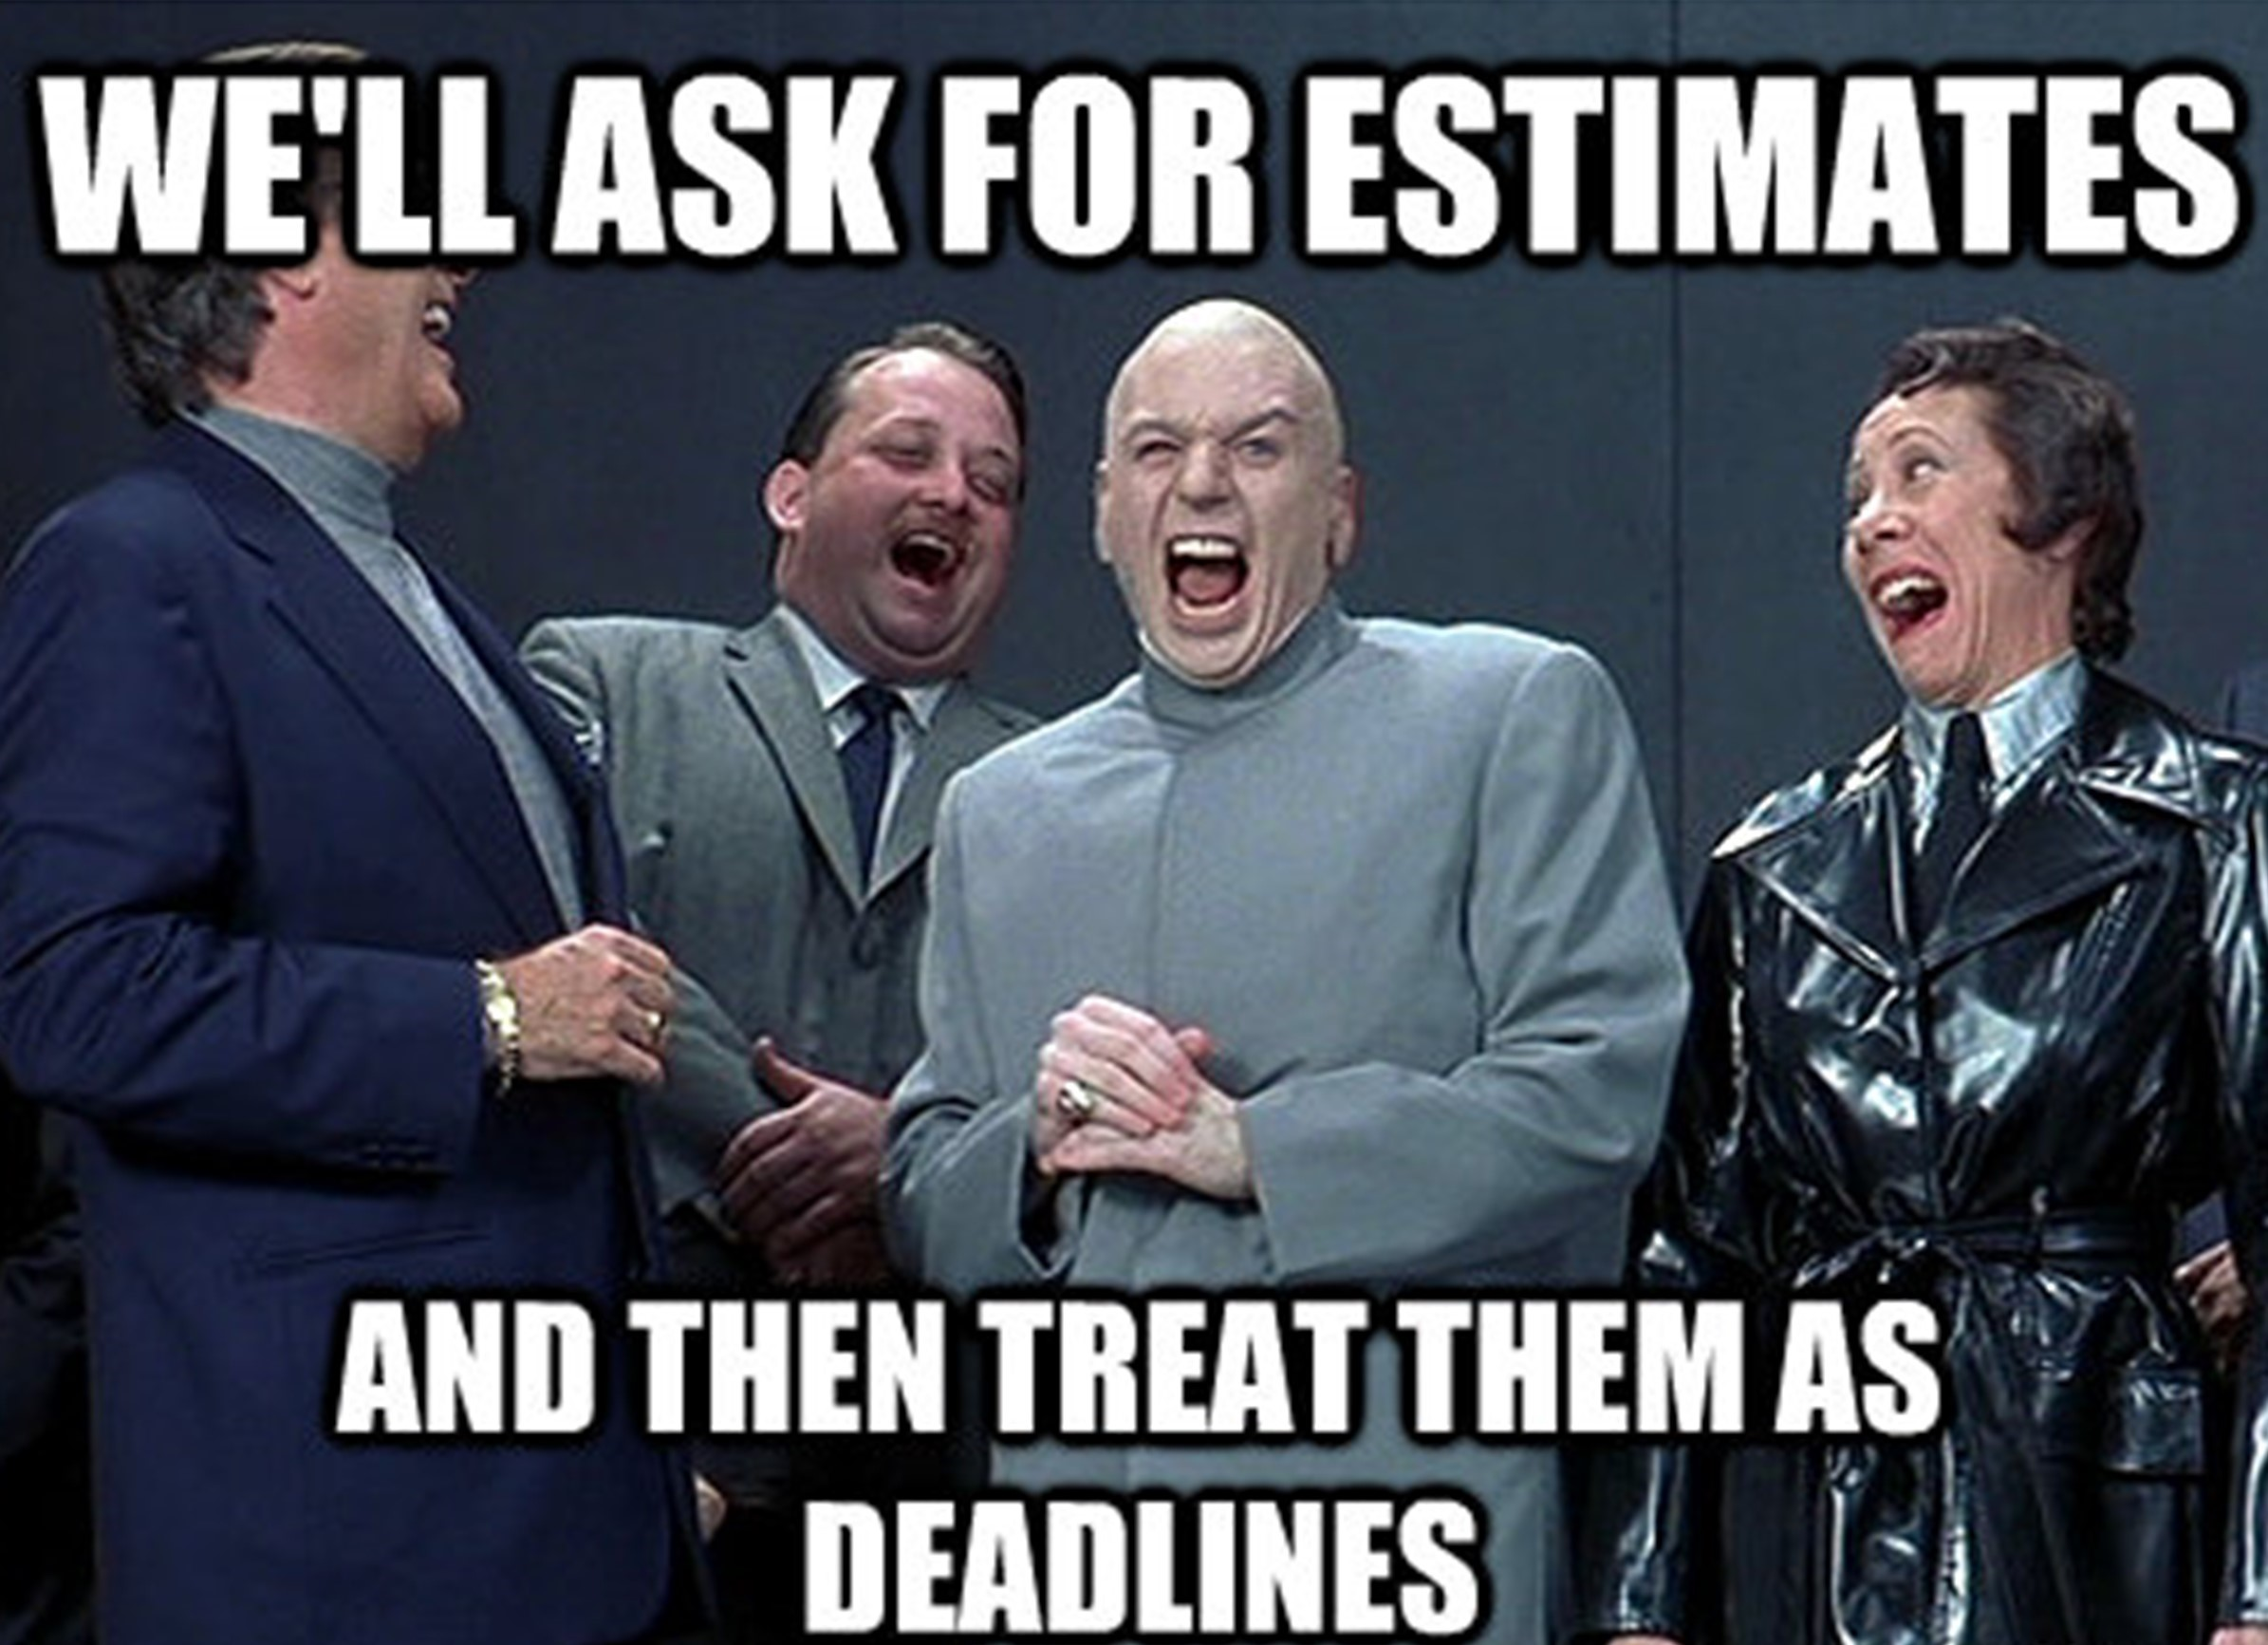
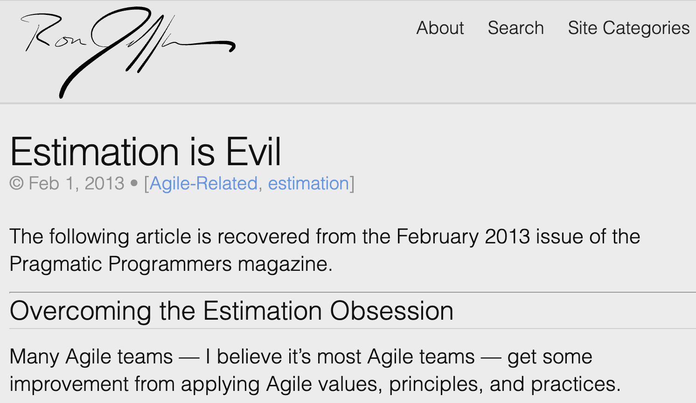
Estimation Techniques
Is Estimation evil?
https://ronjeffries.com/articles/021-01ff/estimation-is-evil/

Slide 11
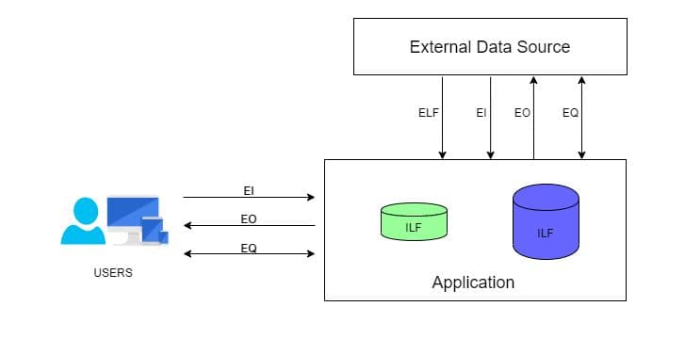
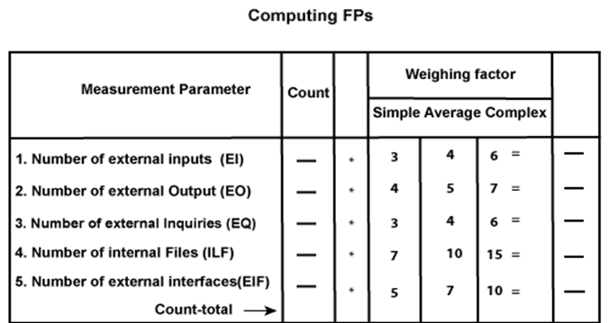
Software Sizing Techniques
Function Point Analysis
Measures the functionality provided to the user based on the logical design.
Components:
External Inputs (EI)
External Outputs (EO)
External Inquiries (EQ)
Internal Logical Files (ILF)
External Interface Files (EIF)

Slide 12
Software Sizing Techniques
Function Point Analysis
Value Adjustment Factor (VAF) consists of 14 General System Characteristics (GSC)
These GSCs represent characteristics of the application under consideration.
Each is weighted on a scale from 0 (low) to 5 (high).
When you sum up the values of these 14 GSCs you get a value named “Total Degree of Influence", or TDI.
As you can see from the math the TDI can vary from 0 (when all GSCs are low) to 70 (when all GSCs are high).
14 GSCs:
Data Communication
Distributed data processing
Performance
Heavily used configuration
Transaction rate
Online data entry
End user efficiency
Online update
Complex processing
Reusability
Installation ease
Operational ease
Multiple sites
Facilitate change
Σ (F_{i}) = Total Degree of Influence (TDI)
VAF = [0.65 + 0.01 x Σ (F_{i})]

Slide 13
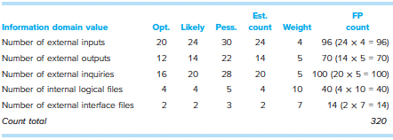
Software Sizing Techniques
Function Point Analysis
The estimated number of FP is derived:
  Assume, Σ (F_{i}) = 52
FP_{estimated} = count-total x [0.65 + 0.01 x Σ (F_{i})]
FP_{estimated} = 374,4 = 375

Slide 14
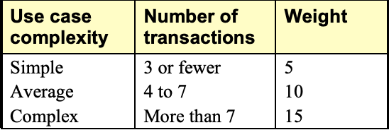
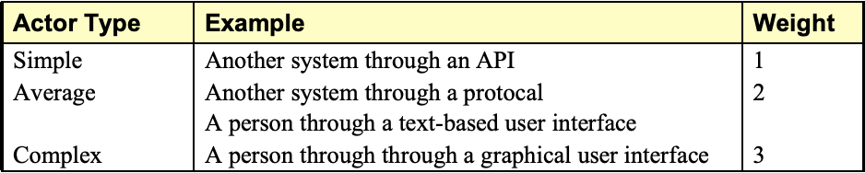
Software Sizing Techniques
Use Case Points
Estimation technique based on use cases
Components:
  Unadjusted Use Case Weight (UUCW)
  Unadjusted Actor Weight (UAW)
  Technical Complexity Factors (TCF)
  Environmental Factors (EF)
Calculation Steps:
  Calculate UUCW and UAW.
  Compute Unadjusted Use Case Points (UUCP):
    UUCP = UUCW + UAW
  Adjust for TCF and EF.
  Calculate Adjusted Use Case Points (UCP):
    UCP = UUCP × TCF × EF
Use Case Weights
Actor Complexity

Slide 15
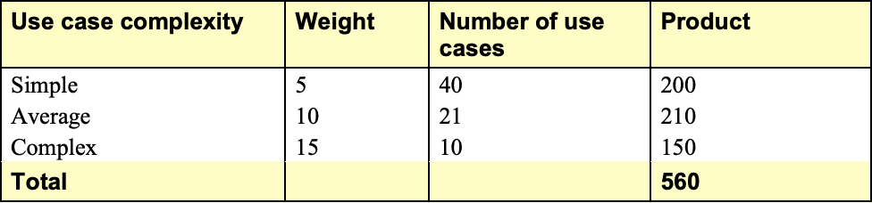
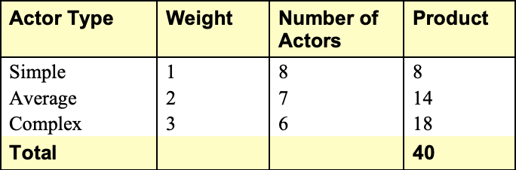
Software Sizing Techniques
Use Case Points
Calculating Unadjusted Use Case Weight (UUCW)
Calculating Unadjusted Actor Weight (UAW)
Calculating Unadjusted Use Case Points (UUCP): UUCW + UAW = 560+40 = 600

Slide 16
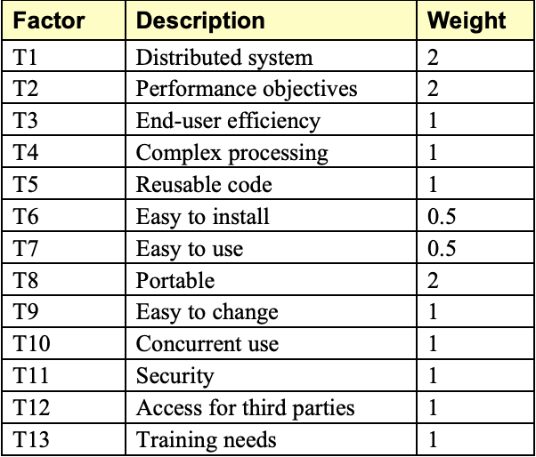
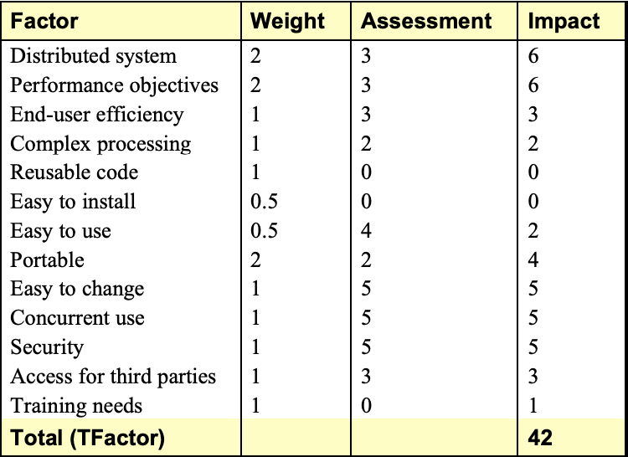
Software Sizing Techniques
Use Case Points: Adjusting for technical complexity
The weight of each factor impacting technical complexity
TCF = 0.6 + (0.01 * TFactor)
TCF = 0.6 + (0.01 * 42) = 1.02

Slide 17
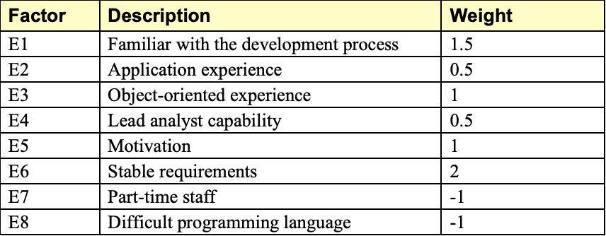
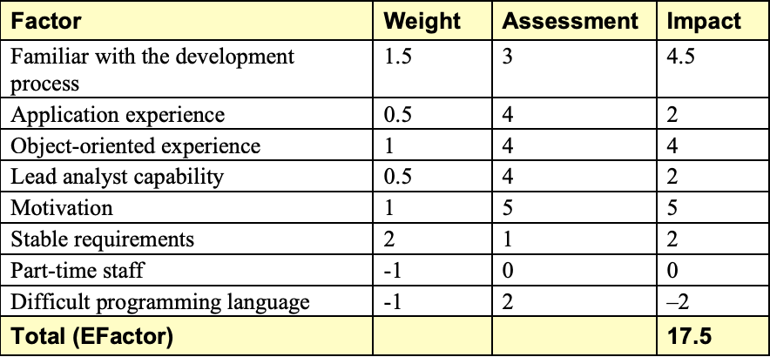
Software Sizing Techniques
Use Case Points: Adjusting for Environmental Complexity
Environmental factors and their weights
EF = 1.4 + (-0.03 * EFactor)
EF = 1.4 + (-0.03 * 17.5) = 1.4 + (-0.51) = 0.89

Slide 18
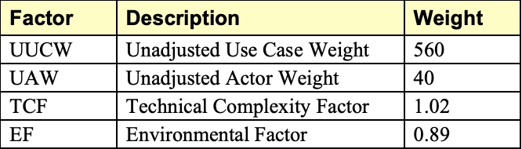
Software Sizing Techniques
Use Case Points: Final Calculation
UCP = UUCW * TCF * EF
UCP = 600 * 1.02 * 0.89 = 545

Slide 19
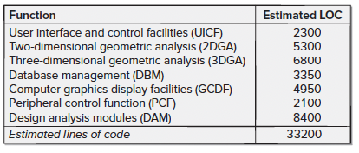
Effort and Cost Estimation Models
LOC Approach
compute LOC/FP using estimates of information domain values
use historical data to build estimates for the project
Average productivity for systems of this type = 620 LOC/pm.
Burdened labor rate =$8000 per month, the cost per line of code is approximately $13.
Based on the LOC estimate and the historical productivity data, the total estimated project cost is $431,000 and the estimated effort is 54 person-months.

Slide 20
Effort and Cost Estimation Models
FP Approach
The estimated number of FP is derived:
FP_{estimated} = 375
organizational average productivity = 6.5 FP/pm.
burdened labor rate = $8000 per month, approximately $1230/FP.
Based on the FP estimate and the historical productivity data, total estimated project cost is $461,000 and estimated effort is 58 person-months.

Slide 21
Effort and Cost Estimation Models
Cocomo II Model
Constructive Cost Model, an algorithmic software estimation model.
COCOMO II is an advanced version of the original COCOMO model developed by Dr. Barry Boehm in 1981. It was introduced in the mid-1990s to address the changing landscape of software development, including:
  Emergence of new software development methodologies.
  Increased use of Commercial Off-The-Shelf (COTS) software.
  Importance of software reuse.
  Development of software in a variety of domains and environments.
Purpose of COCOMO II:
  Provide a framework for estimating software development effort, cost, and schedule.
  Adapt to various project sizes, complexities, and development approaches.
Types:
  Application Composition Model: For early prototyping stages.
  Early Design Model: Uses function points and a set of scale drivers.
  Post-Architecture Model: Most detailed, uses size estimates in LOC.

Slide 22
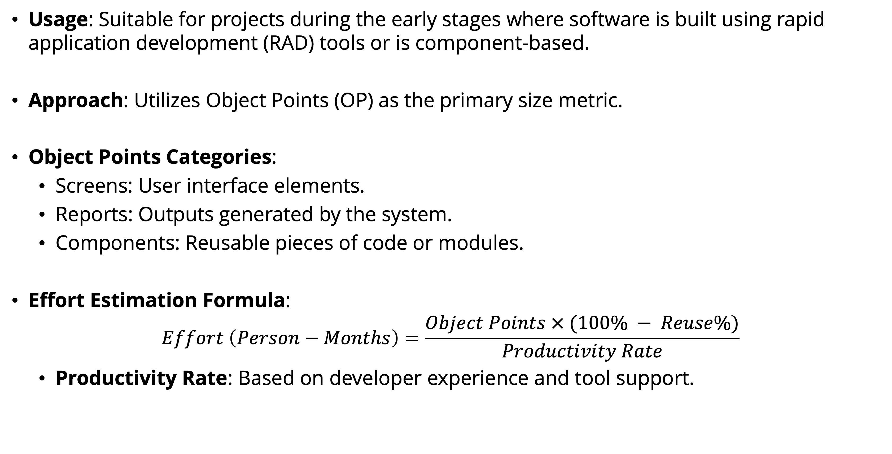
Effort and Cost Estimation Models
Cocomo II Model: Application composition model
Usage: Suitable for projects during the early stages where software is built using rapid application development (RAD) tools or is component-based.
Approach: Utilizes Object Points (OP) as the primary size metric.
Object Points Categories:
  Screens: User interface elements.
  Reports: Outputs generated by the system.
  Components: Reusable pieces of code or modules.
Effort Estimation Formula:
$$Effort \left(Person−Months\right)=\frac{Object Points × (100\% − Reuse\%)}{Productivity Rate}$$
  Productivity Rate: Based on developer experience and tool support.

Slide 23
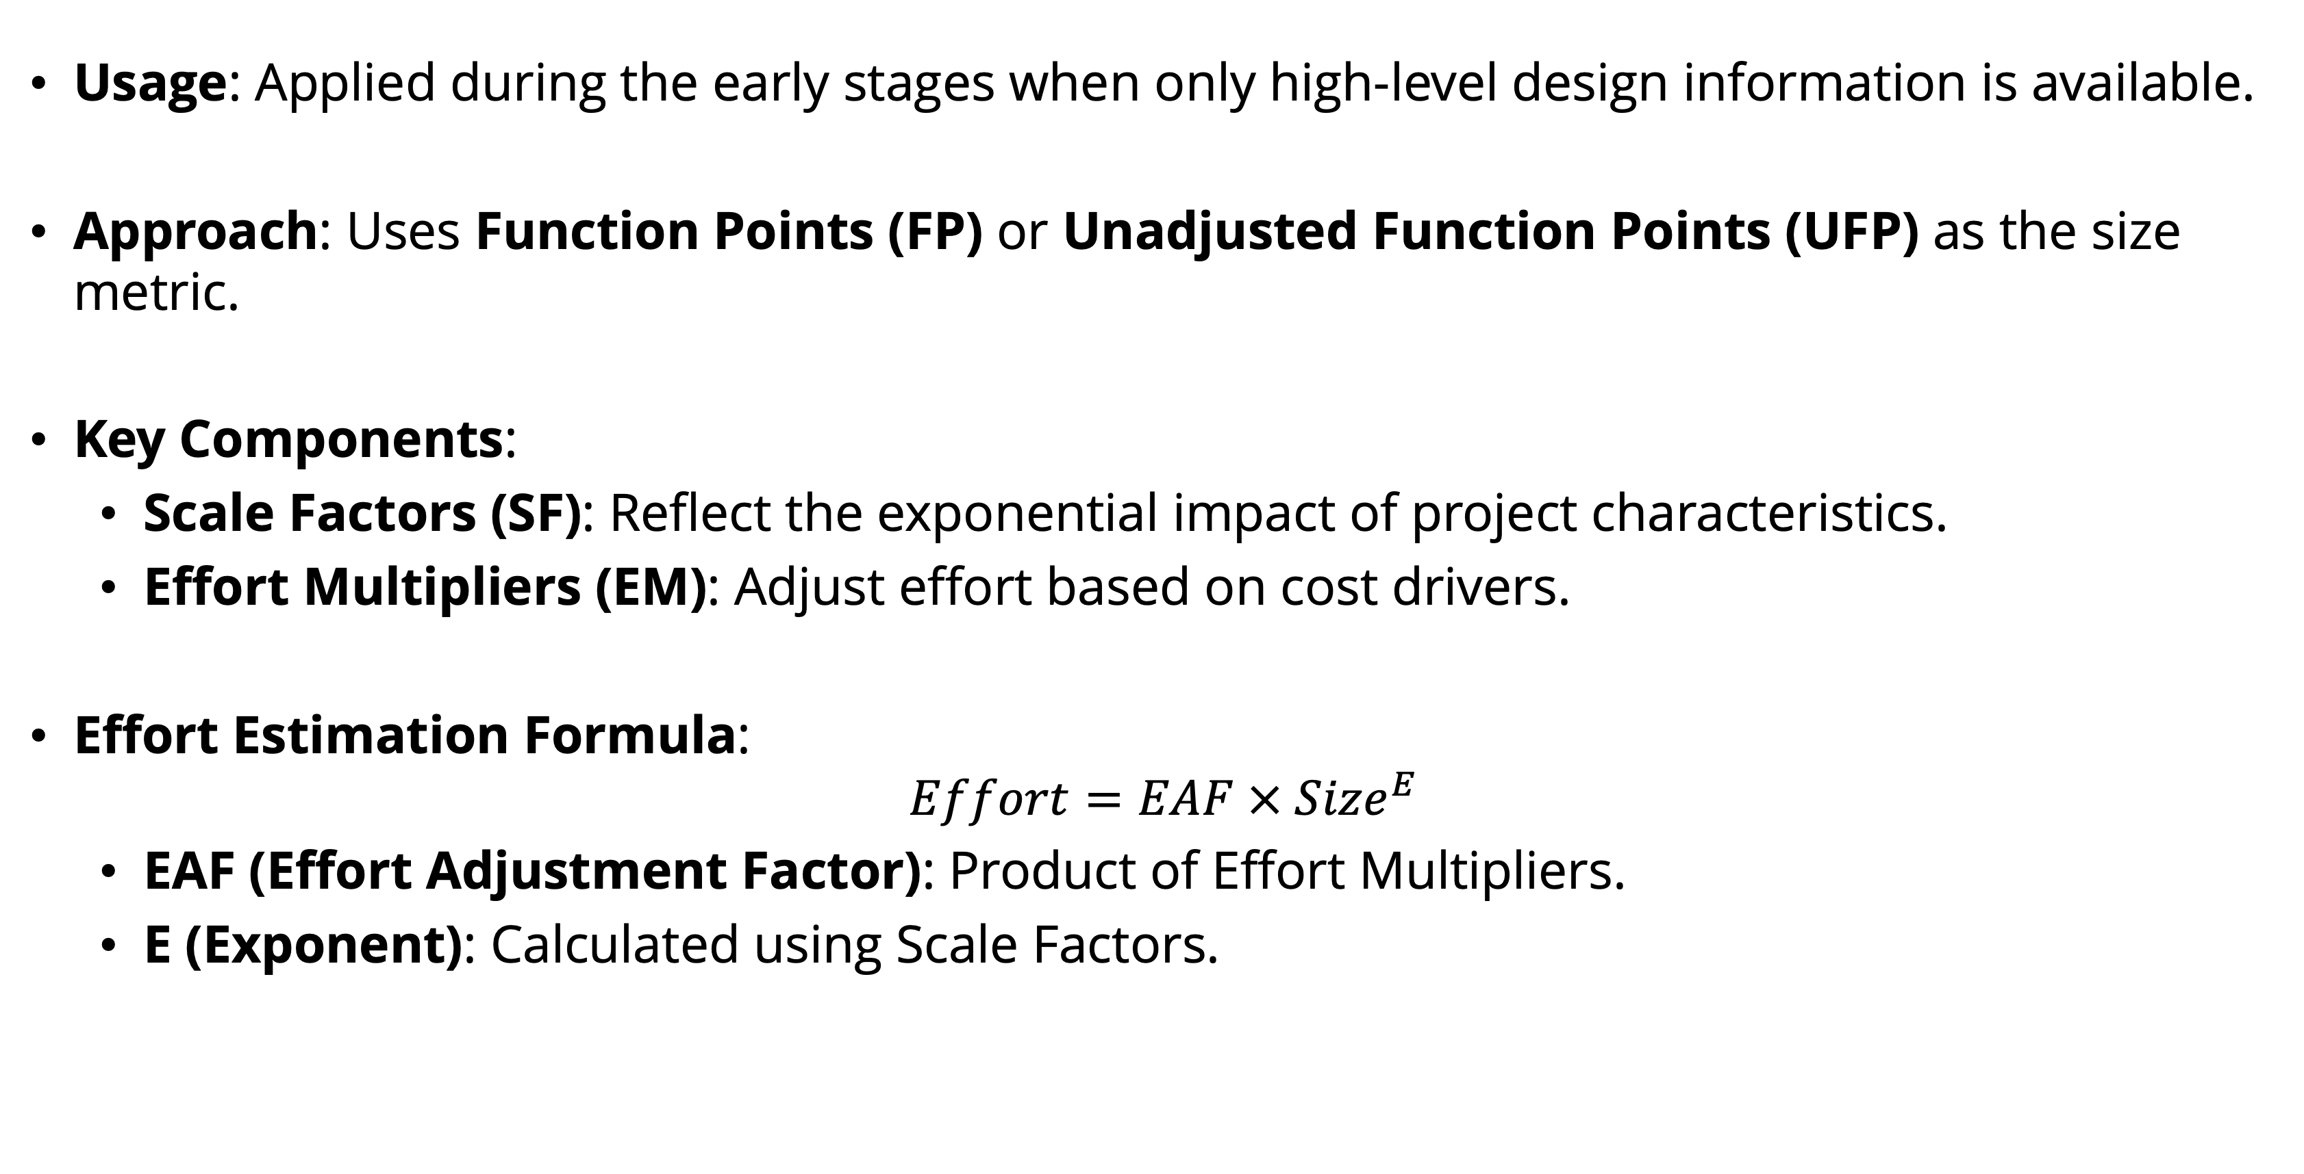
Effort and Cost Estimation Models
Cocomo II Model: Early Design model
Usage: Applied during the early stages when only high-level design information is available.
Approach: Uses Function Points (FP) or Unadjusted Function Points (UFP) as the size metric.
Key Components:
  Scale Factors (SF): Reflect the exponential impact of project characteristics.
  Effort Multipliers (EM): Adjust effort based on cost drivers.
Effort Estimation Formula:
$$Effort=EAF × {Size}^{E}$$
  EAF (Effort Adjustment Factor): Product of Effort Multipliers.
  E (Exponent): Calculated using Scale Factors.

Slide 24
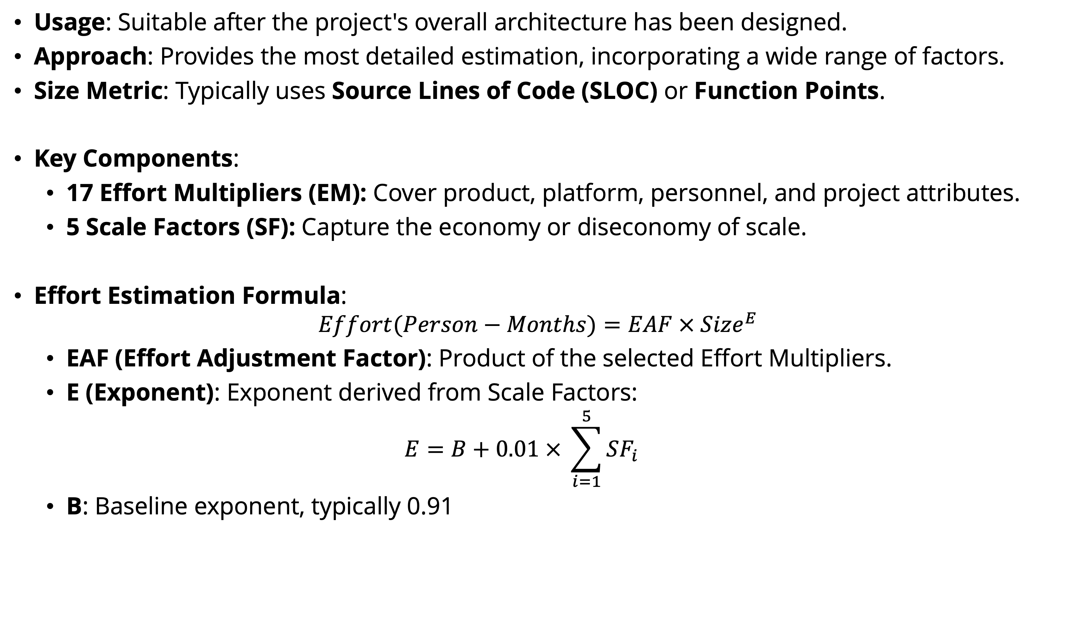
Effort and Cost Estimation Models
Cocomo II Model: Post-Architecture Model
Usage: Suitable after the project's overall architecture has been designed.
Approach: Provides the most detailed estimation, incorporating a wide range of factors.
Size Metric: Typically uses Source Lines of Code (SLOC) or Function Points.
Key Components:
  17 Effort Multipliers (EM): Cover product, platform, personnel, and project attributes.
  5 Scale Factors (SF): Capture the economy or diseconomy of scale.
Effort Estimation Formula:
$$Effort(Person−Months)=EAF × {Size}^{E}$$
  EAF (Effort Adjustment Factor): Product of the selected Effort Multipliers.
  E (Exponent): Exponent derived from Scale Factors:
  $$E=B+0.01 × \sum_{i=1}^{5}{SF_{i}}$$
  B: Baseline exponent, typically 0.91

Slide 25
Effort and Cost Estimation Models
Detailed Components of Cocomo II: Scale Factors (SF)
Scale Factors determine the economies or diseconomies of scale in the project. The five Scale Factors are:
  PREC (Precedentedness): Reflects previous experience with similar projects.
  FLEX (Development Flexibility): Degree of flexibility in the development process.
  RESL (Architecture/Risk Resolution): Level of risk management and architecture analysis.
  TEAM (Team Cohesion): How well the team works together.
  PMAT (Process Maturity): Maturity of the organization's software process.
Rating Levels: Each Scale Factor is rated on a scale from Very Low to Extra High, with associated numeric values.

Slide 26
Effort and Cost Estimation Models
Detailed Components of Cocomo II: Scale Factors (SF)
Example:
The sum of these values is used to calculate the exponent E.
Scale Factor | Very Low | Low | Nominal | High | Very High | Extra High
PREC | 6.20 | 4.96 | 3.72 | 2.48 | 1.24 | 0.00
FLEX | 5.07 | 4.05 | 3.04 | 2.03 | 1.01 | 0.00
RESL | 7.07 | 5.65 | 4.24 | 2.83 | 1.41 | 0.00
TEAM | 5.48 | 4.38 | 3.29 | 2.19 | 1.10 | 0.00
PMAT | 7.80 | 6.24 | 4.68 | 3.12 | 1.56 | 0.00

Slide 27
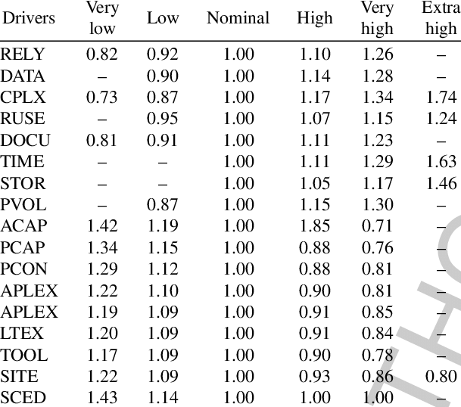
Effort and Cost Estimation Models
Detailed Components of Cocomo II: Effort Multipliers (EM)
Effort Multipliers adjust the estimated effort based on specific project attributes. There are 17 EMs divided into four categories:
Product Factors:
  RELY (Required Software Reliability)
  DATA (Database Size)
  CPLX (Product Complexity)
  RUSE (Required Reusability)
  DOCU (Documentation Match to Life-Cycle Needs)
Platform Factors:
  TIME (Execution Time Constraint)
  STOR (Main Storage Constraint)
  PVOL (Platform Volatility)
Personnel Factors:
  ACAP (Analyst Capability)
  PCAP (Programmer Capability)
  PCON (Personnel Continuity)
  APEX (Applications Experience)
  PLEX (Platform Experience)
  LTEX (Language and Tool Experience)
Project Factors:
  TOOL (Use of Software Tools)
  SITE (Multisite Development)
  SCED (Required Development Schedule)
Rating Levels: Similar to Scale Factors, each EM is rated from Very Low to Extra High, with corresponding numeric multipliers.
The EMs are multiplied together to obtain the EAF.

Slide 28
Steps for using the post-architecture model
Step 1: Estimate Size
Determine the size of the software to be developed.
Size Metrics: Use SLOC or Function Points.
Considerations:
  Exclude reused code (unless significant modifications are required).
  Include new code to be developed.

Slide 29
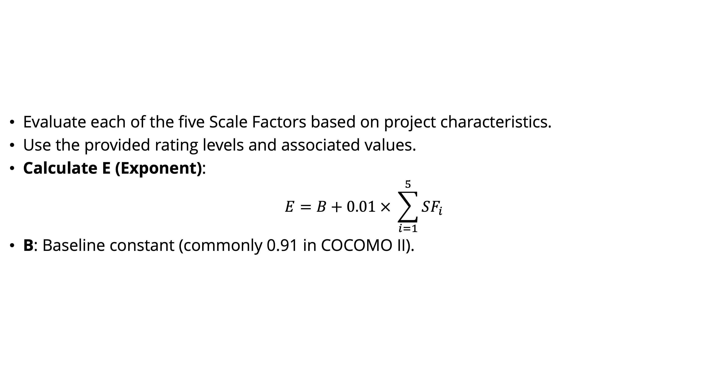
Steps for using the post-architecture model
Step 2: Rate Scale Factors
Evaluate each of the five Scale Factors based on project characteristics.
Use the provided rating levels and associated values.
Calculate E (Exponent):
$$E=B+0.01 × \sum_{i=1}^{5}{SF_{i}}$$
B: Baseline constant (commonly 0.91 in COCOMO II).

Slide 30
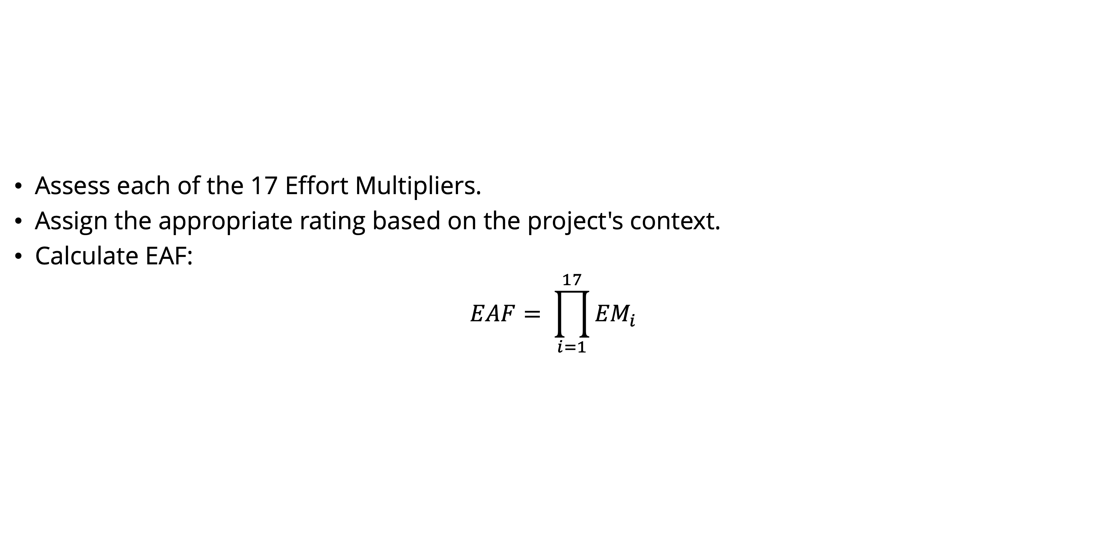
Steps for using the post-architecture model
Step 3: Rate Effort Multipliers
Assess each of the 17 Effort Multipliers.
Assign the appropriate rating based on the project's context.
Calculate EAF:
$$EAF= \prod_{i=1}^{17}{{EM}_{i}}$$

Slide 31
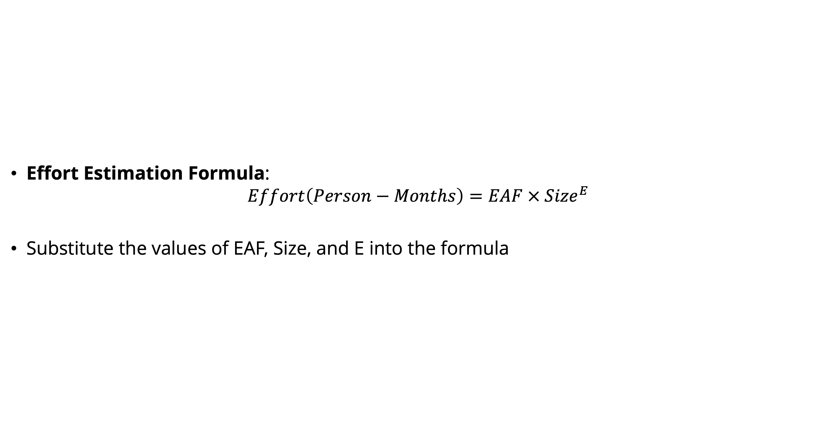
Steps for using the post-architecture model
Step 4: Calculate Effort
Effort Estimation Formula:
$$Effort\left(Person−Months\right)=EAF × {Size}^{E}$$
Substitute the values of EAF, Size, and E into the formula

Slide 32
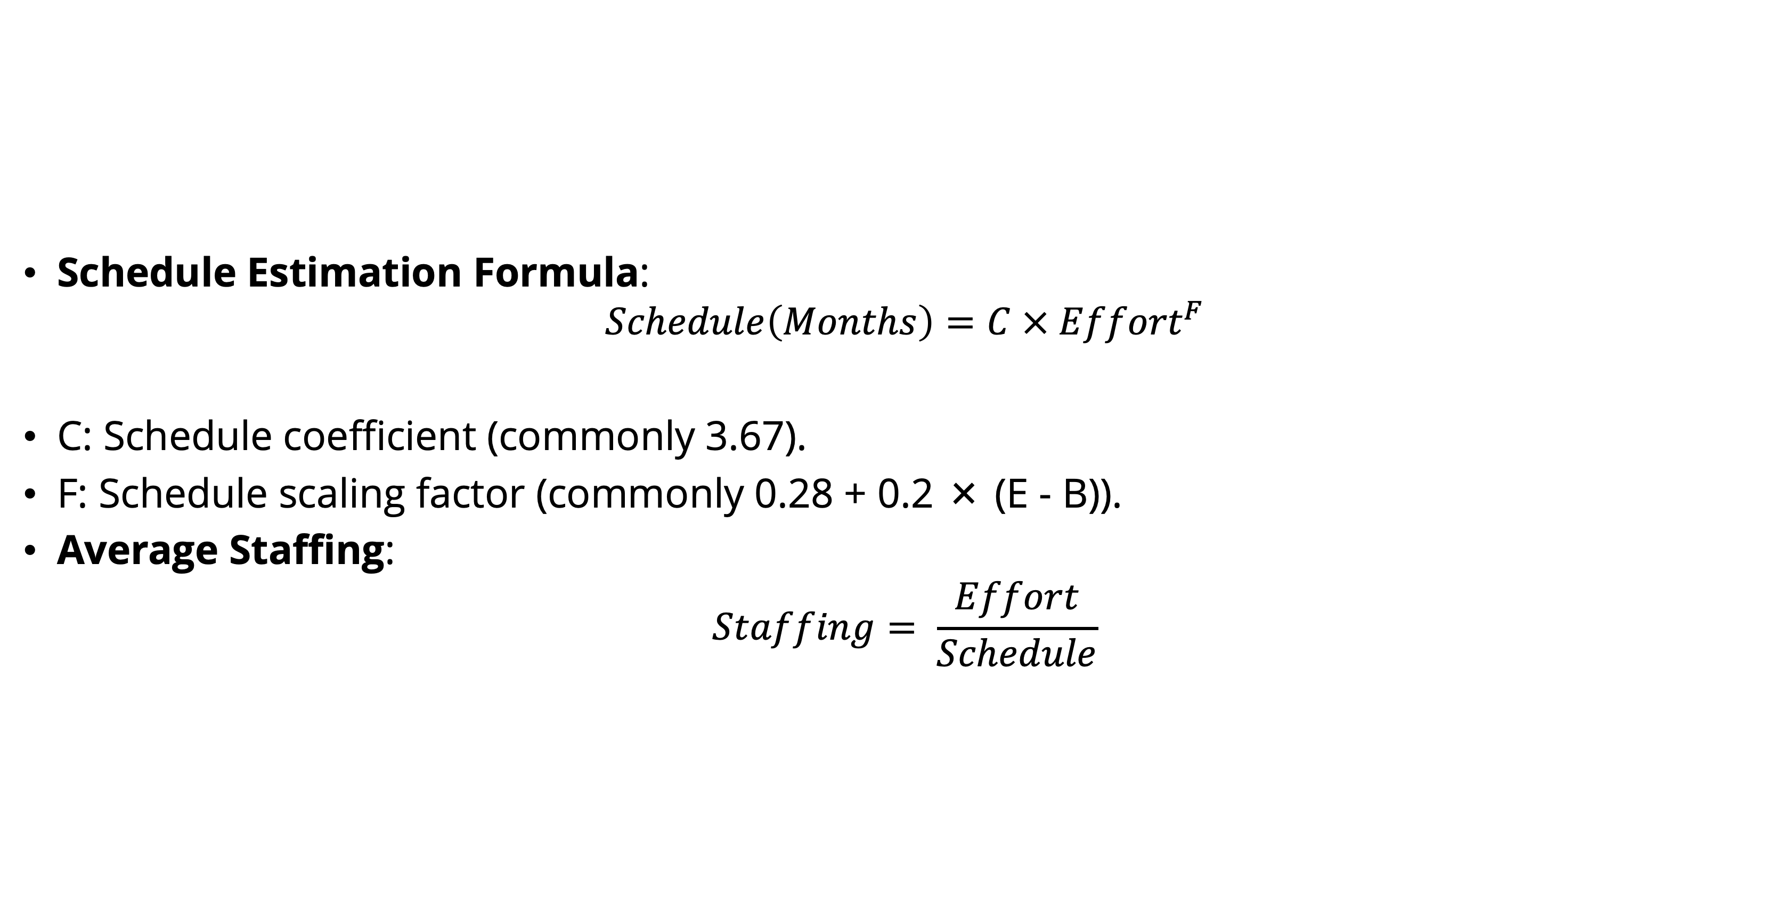
Steps for using the post-architecture model
Step 5: Estimate Schedule and Staffing
Schedule Estimation Formula:
$$Schedule\left(Months\right)=C × {Effort}^{F}$$
C: Schedule coefficient (commonly 3.67).
F: Schedule scaling factor (commonly 0.28 + 0.2 × (E - B)).
Average Staffing:
$$Staffing= \frac{Effort}{Schedule}$$

Slide 33
References
Titus Winters, Tom Manshreck, and Hyrum Wright. (2020). Software Engineering at Google: Lesson Learned from Programming Over Time. 1st. O’Reilly Media. California. ISBN: 978-1492082798. Page 69-122.
Roger Pressman and Bruce Maxim. (2020). Software Engineering: A Practitioner's Approach. 9th. McGraw Hill. New York. ISBN: 978-1259872976. Chapter 24.
Ian Sommerville. (2016). Software Engineering. 10th. Pearson. London. ISBN: 978-1-292-09613-1. Chapter 22.

